Slide 1
Segurança na IoT Perspectiva geral e o caso SmartThings
Seminário
2019
Nuno Santos

Slide 2
O que é a Internet of Things (IoT)?
O último grito na evolução da Internet: comunicações machine-to-machine (ou device-to-device)

Slide 3
Definição de IoT
“Network of physical objects, devices, vehicles, buildings and other items embedded with electronics, software, sensors, and network connectivity that enables these objects to collect and exchange data.”
Wikipedia
“Network of physical objects that contain embedded technology to communicate and sense or interact with their internal states or the external environment.”
Gartner

Slide 4
Mais definições
“It is a global network of interconnected objects, uniquely identifiable based on a standard communication protocol.”
[CERP-IoT 2010]
“The Internet of Things allows people and things to be connected Anytime, Anyplace, with Anything and Anyone, ideally using Any path/network and Any service.”
[Perera et al. 2014]

Slide 5
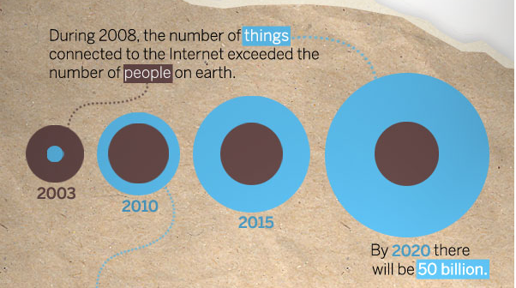
“Coisas” ligadas à Internet

Slide 6
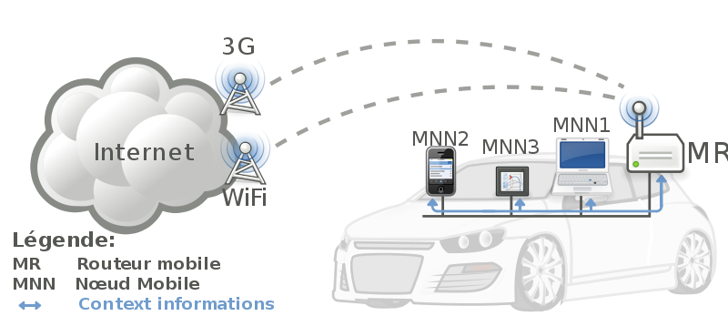


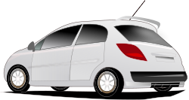
“Coisas” ligadas a “coisas”
- Complex and heterogeneous
resources and networks

Slide 7





Pessoas ligadas a “coisas”
ECG sensor
Internet
Motion sensor
Motion sensor
Motion sensor

Slide 8
“IoT enables de future”

Slide 9
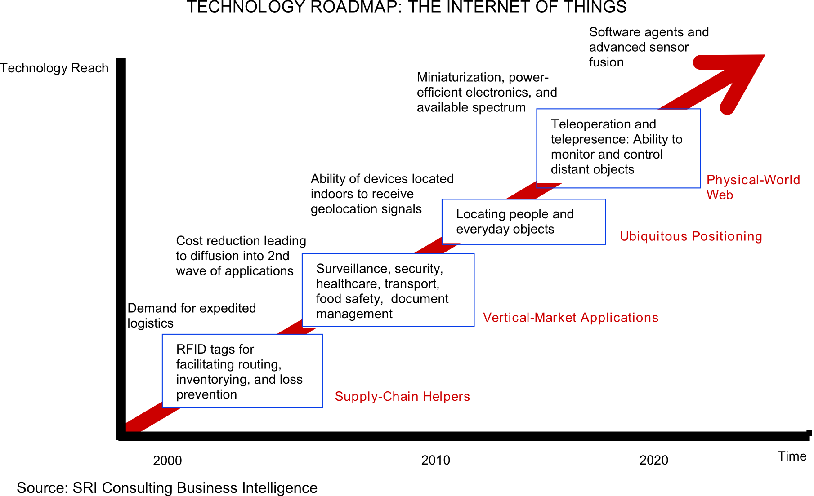
Tendências da tecnologia

Slide 10






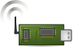
Proliferação de redes wireless de sensores
End-user
Core network
e.g. Internet
Gateway
Sink
node
Gateway
Computer services
As redes tipicamente envolvem dispositivos de baixo consumo
Consistem em um ou mais sensores, podem ser de diferentes tipos (ou actuadores)

Slide 11
Ecosistema IoT oferecido por provedor de serviço

Slide 12
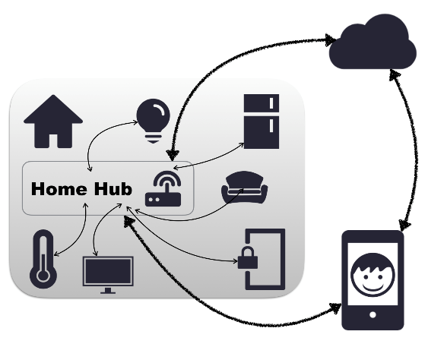
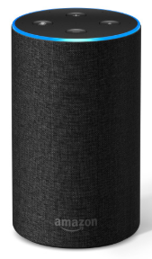
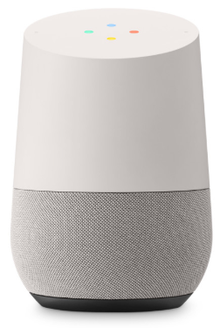

SmartHome: Casa inteligente
Plataformas para SmartHome usam home hubs para interligar smart devices de diferentes fabricantes
Amazon Echo
Google Home
Apple HomeKit
Samsung SmartThings
Notes:
Tecnologia emergente que suporta interligação e controlo inteligente de dispositivos e permite que collaborem entre eles

Slide 13
Duas faces da segurança: safety e segurança
Notes:
https://www.ipa.go.jp/files/000053921.pdf

Slide 14
Problemas de safety: Exemplos de acidentes
Notes:
https://www.ipa.go.jp/files/000053921.pdf

Slide 15
Problemas de security: Exemplos de incidentes
Notes:
https://www.ipa.go.jp/files/000053921.pdf

Slide 16
Outro exemplo de violação de security
Roubo de grandes quantidades de informação devido a infecção de terminais POS por malware
In 2013, it was found that POS terminals of a large retail chain in the U.S. were infected by malware (malicious software), and credit card information of 40 million customers and personal information of 70 million customers were leaked.
Notes:
https://www.ipa.go.jp/files/000053921.pdf

Slide 17
Exemplo onde safety e security são afectados
Pacemakers cardíacos podem ser parados via wireless
In 2012, a U.S. researcher published an experiment, showing that transmission equipment can make cardiac pacemakers deliver a fatal electric current to hearts or falsify software in the pacemakers from a distance of less than 10m.
Notes:
https://www.ipa.go.jp/files/000053921.pdf

Slide 18
O que vamos ver a seguir
Riscos e desafios de segurança em IoT
Segurança na plataforma SmartThings

Slide 19
Riscos e desafios de segurança em IoT

Slide 20


Estudo realizado pela IETF
Draft: Security Considerations in the IP-based Internet of Things
Torna-se um IRTF Internet Draft em 2016
State-of-the-Art and Challenges for the Internet of Things Security
https://tools.ietf.org/html/draft-irtf-t2trg-iot-seccons-16
Também bom sumário das iniciativas de standardização
Notes:
The Internet Research Task Force (IRTF) focuses on longer term research issues related to the Internet while the parallel organization, the Internet Engineering Task Force (IETF), focuses on the shorter term issues of engineering and standards making.
https://irtf.org/

Slide 21

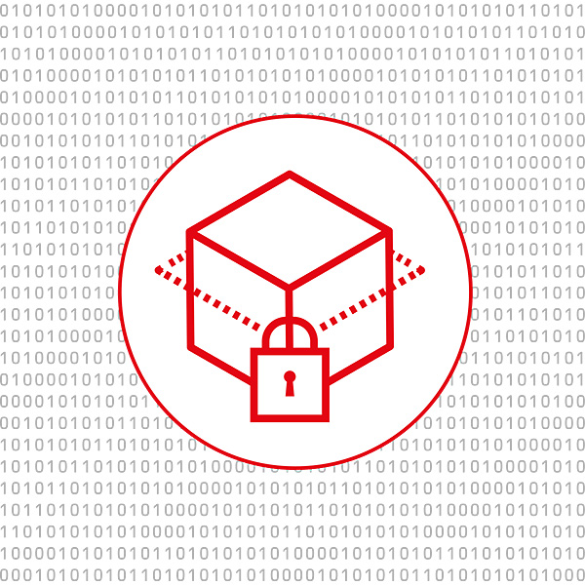





Dimensões da segurança em IoT
Security
Confidentiality
Authentication
Integrity
Authorization
Availability
24h available

Slide 22









Vulnerabilidades no ciclo de vida das “coisas”
Manufactured
Installed
Software update
Decommissioned
Commissioned
Reconfigured
Removed & replaced
Reownership & recommissioned
Application Running
Application Running
Bootstrapping
Operational
Maintenance & re-bootstrapping
Operational
Maintenance & re-bootstrapping

Slide 23
Vulnerabilidades no ciclo de vida das “coisas”
Manufactured
Installed
Software update
Decommissioned
Commissioned
Reconfigured
Removed & replaced
Reownership & recommissioned
Application Running
Application Running
Bootstrapping
Operational
Maintenance & re-bootstrapping
Operational
Maintenance & re-bootstrapping

Slide 24

Ameaças de segurança para as “coisas”
Cloning of things
Clone firmware, security configurations
Reverse engineer
Change functionality/add a backdoor
Manufacturing
Application Running

Slide 25

Ameaças de segurança para as “coisas”
Malicious substitution of things
Different device is installed during Installation phase
Installation

Slide 26

Ameaças de segurança para as “coisas”
Eavesdropping attack
Security parameters exchanged in clear text
Device lifetime exceeds the cryptographic algorithms lifetime
Messages during T2T communication
Commissioning
Application operational
Notes:
Comissioning = configuração

Slide 27


Ameaças de segurança para as “coisas”
Man-in-the-middle attack
Security parameters update exchanged in clear text
If device authentication is human-assisted, it may create a weak link
Hub
Commissioning
Application operational
Notes:
Comissioning = configuração

Slide 28
Ameaças de segurança para as “coisas”
Firmware attacks
During maintenance a new malicious firmware may be updated
Old firmware may contain security exploits
Software update
Application operational
Notes:
Comissioning = configuração

Slide 29

Ameaças de segurança para as “coisas”
Privilege scalation
Authentication system flaw
Low privileged user access higher priority resources
Notes:
Comissioning = configuração

Slide 30







Ameaças de segurança para as “coisas”
Privacy threats
Infer information based on device profile and messaging patterns
Also known as second channel attack
Notes:
Comissioning = configuração

Slide 31

Ameaças de segurança para as “coisas”
Denial-of-Service attack
Physically jamming the network medium
Constrained devices are more vulnerable
Resource exhaustion
Compromised devices used in a Distributed DoS
Notes:
Comissioning = configuração

Slide 32
Desafios para IoT segura
Resource constraints
Lossy and low-bandwidth communication channels
Possible DoS exploit, due to losses and retransmissions
Scarce processing and memory capacity limits the usage of resource expensive cryptographic primitives
Efforts in more efficient cryptography

Slide 33
Desafios para IoT segura
End-to-end security, protocol translation, and the role of middleboxes
Sender to receiver confidentiality and integrity
Encryption commonly used
Gateways can’t change or access the data
Constrained IoT networks uses different protocols that may needs translation at middleboxes
Middleboxes must access the message being sent (no end-to-end security)
Middlebox
Internet

Slide 34
Desafios para IoT segura
Solutions for end-to-end security challenge
Share credentials with middleboxes
Selectively protecting vital and immutable packet parts within a message, may result in poor performance or poor security
Encrypt and integrity protect most of the message fields except those parts that a middlebox needs to read or change
Homomorphic encryption techniques
Limited to arithmetic operations
Not many libraries with good support yet

Slide 35
Desafios para IoT segura
Bootstrapping of a security domain
Creating a security domain from unassociated IoT devices
Still an unresolved question
Manufactured
Installed
Commissioned
Bootstrapping

Slide 36
Desafios para IoT segura
Operational stage challenges
Group Membership and Security
Group key solutions can be reused in IoT

Slide 37
Desafios para IoT segura
Mobility and IP network dynamics
Expected that things will be attached to different networks during its lifetime (wearable sensors)
Hub1
Hub2

Slide 38
Desafios para IoT segura
Secure software update and cryptographic agility
IoT devices are often expected to stay functional for several years and decades
Unattended operation
Software updates needed for new functionalities and security vulnerabilities
No incentive by manufactures
No source code available
Manual update
All the update threats
Source authentication

Slide 39
Desafios para IoT segura
Verifying device behavior
How guarantee e that a device is doing what it claims
Devices may need to connect to the manufactures server, how can a user tell what data is being sent?
Challenging
Devices are not only constrained in resources but also in interface
Place of deployment will vary
It’s a open question
Some solutions
Manufacturer Usage Description (MUD) files [ID-MUD]
A first step in this direction
Describes what the device is supposed to the network
network monitoring service can then alert the user if the device does not behave as expected
Notes:
Manufacturer Usage Description (MUD) is an embedded software standard defined by the IETF that allows IoT Device makers to advertise device specifications, including the intended communication patterns for their device when it connects to the network.
https://developer.cisco.com/docs/mud/#!what-is-mud

Slide 40
Desafios para IoT segura
Testing and bug hunting and vulnerabilities
It remains an open issue how classic quality assurance and bug testing will adapt to IoT devices
Also the combination of devices from different vendors may lead to dangerous network configurations
Notes:
Manufacturer Usage Description (MUD) is an embedded software standard defined by the IETF that allows IoT Device makers to advertise device specifications, including the intended communication patterns for their device when it connects to the network.
https://developer.cisco.com/docs/mud/#!what-is-mud

Slide 41
Desafios para IoT segura
Privacy protection
Second channel attacks
Defined as
awareness of privacy risks imposed by smart things
individual control over the collection and processing of personal information
awareness and control of subsequent use and dissemination of personal information by those entities to any entity outside the subject’s personal control sphere

Slide 42
Desafios para IoT segura
Threats to user privacy
Identification - refers to the identification of the users and their objects
Localization - relates to the capability of locating a user and even tracking them
Profiling - is about creating a profile of the user and their preferences
Interaction - occurs when a user has been profiled and a given interaction is preferred (targeted marketing)
Lifecycle transitions - take place when devices are, for example, sold without properly removing private data
Inventory attacks - happen if specific information about (smart) objects in possession of a user is disclosed
Linkage - is about when information of two of more IoT systems is combined so that a broader view on the personal data is created
Still an open issue

Slide 43
Desafios para IoT segura
Trustworthy IoT operation
Flaws in the design and implementation of a secure IoT device
Same built in password for all devices (as Dr. Mosse mentioned about routers)
Tools to find IoT devices in the Internet
https://www.shodan.io/

Slide 44
OWASP IoT top 10 vulnerabilities 2018
https://www.owasp.org/images/1/1c/OWASP-IoT-Top-10-2018-final.pdf
I1 Weak Guessable, or Hardcoded Passwords
I2 Insecure Network Services
I3 Insecure Ecosystem Interfaces
I4 Lack of Secure Update Mechanism
I5 Use of Insecure or Outdated Components
I6 Insufficient Privacy Protection
I7 Insecure Data Transfer and Storage
I8 Lack of Device Management
I9 Insecure Default Settings
I10 Lack of Physical Hardening

Slide 45
Três problemas sérios na plataforma SmartThings
Como impedir que as aplicações tenham acesso abusivo aos smartdevices dos utilizadores?
Como impedir que as aplicações efectuem acções sem o conhecimento dos utilizadores?
Como impedir que diferentes aplicações interfiram entre si causando resultados inesperados pelos utilizadores?

